Slide 2
When should you use MongoDB …. And when you should not….
Edouard Servan-Schreiber, Ph.D. Director for Solution Architecture MongoDB edss@mongodb.com

Slide 3
Agenda
What is MongoDB?
What is MongoDB for?
What does MongoDB do very well…. And less well
What do customers do very well with MongoDB, and what they do not do
Some unusual use cases
When you should use MongoDB

Slide 4
CREATE APPLICATIONS NEVER BEFORE POSSIBLE
AGILE | SCALABLE

Slide 5
What is MongoDB for?
The data store for all systems of engagement
Demanding, real-time SLAs
Diverse, mixed data sets
Massive concurrency
Globally deployed over multiple sites
No downtime tolerated
Able to grow with user needs
High uncertainty in sizing
Fast scaling needs
Delivers a seamless and consistent experience

Slide 6
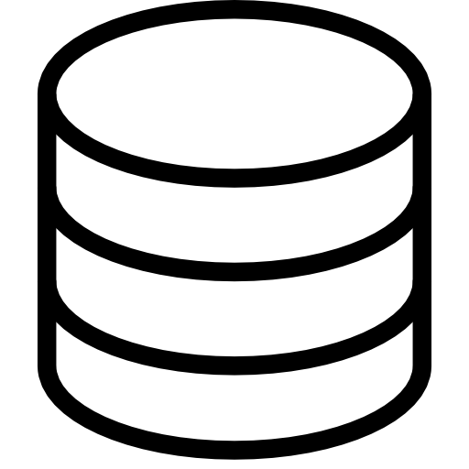
Relational
Expressive Query Language
Flexibility
Strong
Consistency
Scalability
Secondary Indexes
Performance
Notes:
Looking at the other technologies in the market…
Relational databases laid the foundation for what you’d want out of your database
Rich and fast access to the data, using an expressive query language and secondary indexes
Strong consistency, so you know you’re always getting the most up to date version of the data
But they weren’t built for the world we just talked about
Built for waterfall dev cycles, structured data
Built for internal users, not large numbers of users all across the global
(From vendors who want large license fees upfront)
--> So what they have in data access and consistency, they lack in flexibility, scalability and performance

Slide 7
NoSQL
Expressive Query Language
Flexibility
Strong
Consistency
Scalability
Secondary Indexes
Performance
Notes:
NoSQL databases have tried to address the new world…
They all have relatively flexible data models
They were all built to scale out horizontall
And they were built for performance
But in doing so, they have sacrificed the core database capabilities you’ve come to expect and rely on in order to build fully functional apps, like rich querying, secondary indexes and strong consistency

Slide 8

Relational
NoSQL
Expressive Query Language
Flexibility
Strong
Consistency
Scalability
Secondary Indexes
Performance
Relational + NoSQL
Notes:
MongoDB was built to address the way the world has changed while preserving the core database capabilities required to build functional apps
MongoDB is the only database that harnesses the innovations of NoSQL and maintains the foundation of relational databases

Slide 9
Nexus Architecture
Expressive Query Language
Flexibility
Strong
Consistency
Scalability
Secondary Indexes
Performance
Relational + NoSQL
Notes:
MongoDB was built to address the way the world has changed while preserving the core database capabilities required to build functional apps
MongoDB is the only database that harnesses the innovations of NoSQL and maintains the foundation of relational databases

Slide 10
What MongoDB is NOT
An analytical suite
Not competing with SAS or SPSS
A data warehouse technology
Not competing with Teradata, Netezza, Vertica
A BI tool
Not competing with Tableau or QlikView
Backoffice transaction processing
Not competing with IBM Mainframes
Backend for a billing system or general ledger system
Not competing with Oracle RAC
A search engine
Not competing with Elasticsearch, SOLR

Slide 11
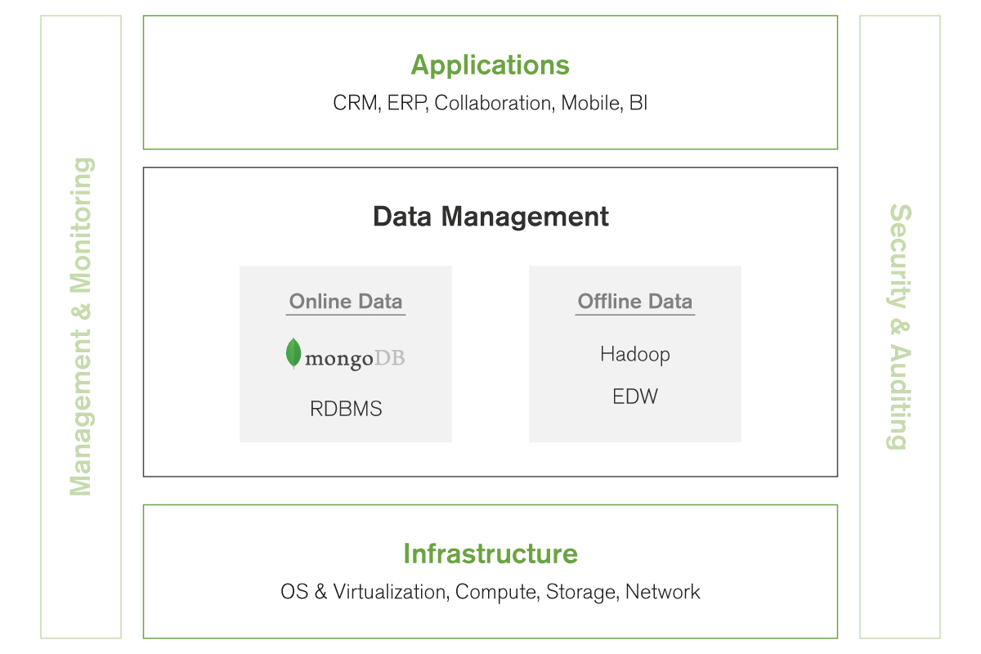
MongoDB and Enterprise IT Stack
Notes:
This is where MongoDB fits into the existing enterprise IT stack
MongoDB is an operational data store used for online data, in the same way that Oracle is an operational data store. It supports applications that ingest, store, manage and even analyze data in real-time. (Compared to Hadoop and data warehouses, which are used for offline, batch analytical workloads.)

Slide 12
MongoDB and Enterprise IT Stack
OLTP
OLAP
Notes:
This is where MongoDB fits into the existing enterprise IT stack
MongoDB is an operational data store used for online data, in the same way that Oracle is an operational data store. It supports applications that ingest, store, manage and even analyze data in real-time. (Compared to Hadoop and data warehouses, which are used for offline, batch analytical workloads.)

Slide 13
Factors Driving Modern Applications
Mobile
2 Billion smartphones by 2015
Mobile now >50% internet use
26 Billion devices on IoT by 2020
Data
90% data created in last 2 years
80% enterprise data is unstructured
Unstructured data growing 2X rate
of structured data
Social
72% of internet use is social media
2 Billion active users monthly
93% of businesses use social media
Cloud
Compute costs declining 33% YOY
Storage costs declining 38% YOY
Network costs declining 27% YOY
Notes:
There are many forces at work changing how we build and run applications today:
Development methods have shifted from waterfall patterns that unfold over 12-24 months to iterative patterns that evolve on a monthly basis. Organizations need software and infrastructure that support fast time to market.
Application costs have shifted, from being dominated by costs associated with infrastructure to being dominated by costs associated with engineers. Organizations need software and infrastructure that help to lower engineering costs.
In the background, there is what Gartner calls a “nexus of forces” that are driving massive change in how organizations run their business.
Mobile usage is now >50% of all internet usage. Users are online continuously, throughout the day, and there are more of them than ever before.
Social dominates use of the internet, including 93% of businesses use social media.
Data growth is unprecedented. 90% of all data created in the history of mankind was created in the last two years. Unstructured growing at 2x structured.
Cloud infrastructure costs have been declining approximately 30% YOY for the past two decades.
MongoDB was designed to help organizations capitalize on these trends by providing a database that dramatically speeds how quickly applications can be brought to market, and leverages modern infrastructure trends to drive down costs.

Slide 14

MongoDB Strategic Advantages
Application
Agile
Flexible
High Performance &
Strong Consistency
Highly
Available
-Replica Sets
{ author: “eliot”,
date: new Date(),
text: “MongoDB”,
tags: [“database”, “flexible”, “JSON”]}
Horizontally Scalable
-Sharding

Slide 15
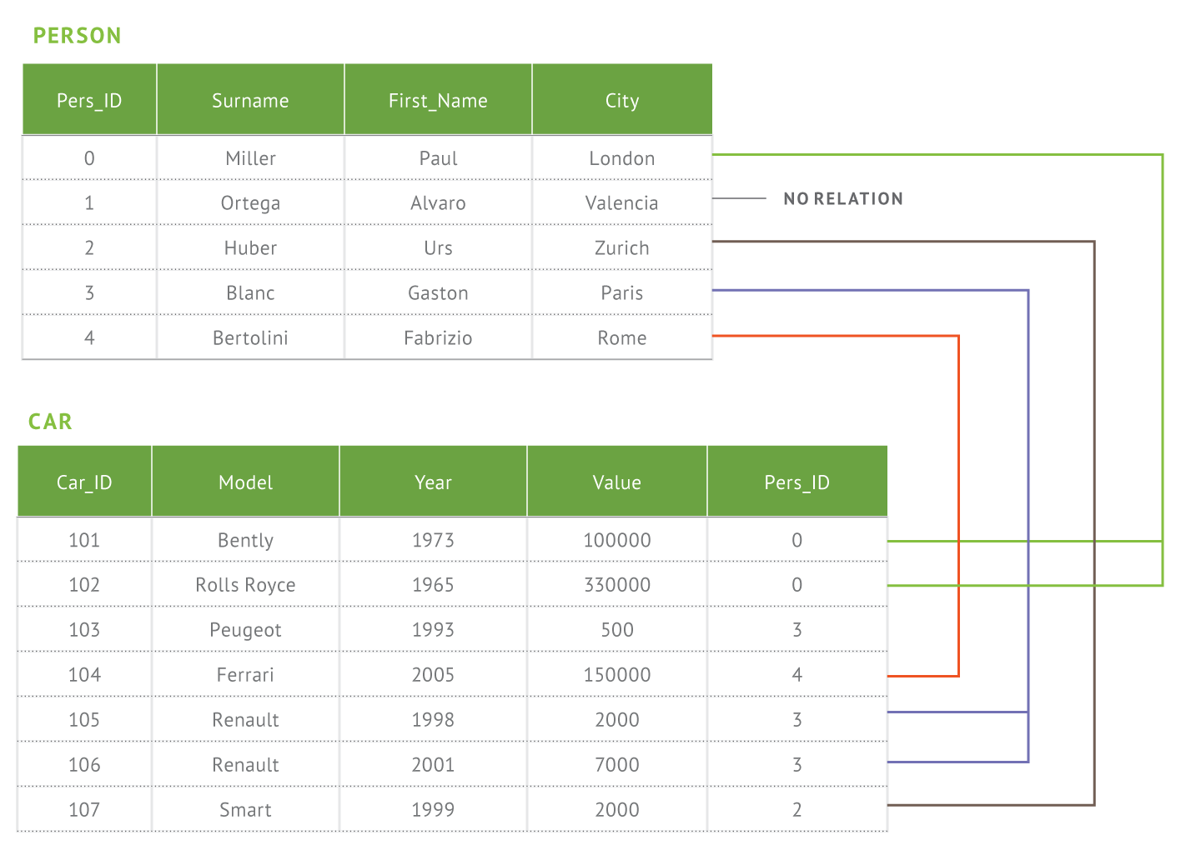
Document Data Model
Relational
MongoDB
{
first_name: ‘Paul’,
surname: ‘Miller’,
city: ‘London’,
location: [45.123,47.232],
cars: [
{ model: ‘Bentley’,
year: 1973,
value: 100000, … },
{ model: ‘Rolls Royce’,
year: 1965,
value: 330000, … }
]
}
Notes:
Here we have greatly reduced the relational data model for this application to two tables. In reality no database has two tables. It is much more common to have hundreds or thousands of tables. And as a developer where do you begin when you have a complex data model?? If you’re building an app you’re really thinking about just a hand full of common things, like products, and these can be represented in a document much more easily that a complex relational model where the data is broken up in a way that doesn’t really reflect the way you think about the data or write an application.

Slide 16
Do More With Your Data
Rich Queries | Find Paul’s cars Find everybody in London with a car built between 1970 and 1980
Geospatial | Find all of the car owners within 5km of Trafalgar Sq.
Text Search | Find all the cars described as having leather seats
Aggregation | Calculate the average value of Paul’s car collection
Map Reduce | What is the ownership pattern of colors by geography over time? (is purple trending up in China?)
MongoDB
{
first_name: ‘Paul’,
surname: ‘Miller’,
city: ‘London’,
location: [45.123,47.232],
cars: [
{ model: ‘Bentley’,
year: 1973,
value: 100000, … },
{ model: ‘Rolls Royce’,
year: 1965,
value: 330000, … }
}
}

Slide 17
Requirements For These Challenges
Addresses | Requirement | Description
Data Types | Hierarchical data structure | Can match the structure of objects in today’s OOP languages
Data Types, Agile | Dynamic schema | Can handle differently shaped data in a table/collection and not a predefined schema
Agile | Native OOP language | Keeps developers in one environment and encapsulates functionality/validation/rules in one place
Volume | Scale | Can efficiently handle 100s tera & petabytes of data
Volumes, New Arch | Performance | High throughput on a single node and scales horizontally easily
Still required | Software cost | Open source with premium value added services
Still required | Data consistency | How soon you can read data that was just written
Still required | Rich querying | Querying based on any field, e.g. secondary indexes
Still required | Ease of use | Short learning curve and easy to design

Slide 18
How Databases Stack Up
Requirement | RDBMS | Key/value | Wide column | MongoDB
Hierarchical data | Poor | Poor | Good | Great
Dynamic schema | Poor | Poor | Poor | Great
Native OOP lang | Poor | Great | Great | Great
Software cost | Poor | Great | Great | Great
Performance | Poor | Great | Great | Great
Scale | Poor | Great | Great | Great
Data consistency | Great | Poor | Poor | Great
Rich querying | Great | Poor | Poor | Great
Ease of use | Good | Good | Poor | Great
Notes:
Add H-M-L

Slide 19
How Databases Stack Up
Requirement | RDBMS | Key/value | Wide column | MongoDB
Hierarchical data | Poor | Poor | Good | Great
Dynamic schema | Poor | Poor | Poor | Great
Native OOP lang | Poor | Great | Great | Great
Software cost | Poor | Great | Great | Great
Performance | Poor | Great | Great | Great
Scale | Poor | Great | Great | Great
Data consistency | Great | Poor | Poor | Great
Rich querying | Great | Poor | Poor | Great
Ease of use | Good | Good | Poor | Great
VALUE OF NOSQL
Notes:
Add H-M-L

Slide 20
How Databases Stack Up
Requirement | RDBMS | Key/value | Wide column | MongoDB
Hierarchical data | Poor | Poor | Good | Great
Dynamic schema | Poor | Poor | Poor | Great
Native OOP lang | Poor | Great | Great | Great
Software cost | Poor | Great | Great | Great
Performance | Poor | Great | Great | Great
Scale | Poor | Great | Great | Great
Data consistency | Great | Poor | Poor | Great
Rich querying | Great | Poor | Poor | Great
Ease of use | Good | Good | Poor | Great
VALUE OF NOSQL
VALUE OF MONGODB
Notes:
Add H-M-L

Slide 21
As a database, where does MongoDB shine?
MongoDB does well | MongoDB does less well
Straightforward replication High performance on mixed workloads of reads, writes and updates Scaling on demand Location based deployments Geo spatial queries High Availability and auto failover Flexible schema & secondary indexing Agile development in most programming languages Commodity infrastructure Real time analytics Text indexing Data consistency Compression | Resource management * Collection scanning under load * Absolute write availability Faceted search Joins across collections SQL* Transactions over multiple docs

Slide 22
As a database, where does MongoDB shine?
MongoDB does well
Straightforward replication High performance on mixed workloads of reads, writes and updates Scaling on demand Location based deployment Geo spatial queries High Availability and auto failover Flexible schema & secondary indexing Agile development in most programming languages Commodity infrastructure Real time analytics Text indexing Data consistency Compression
Easy to initiate
All reads, mixed, and mostly writes
No expensive overprovisioning
One cluster can span the globe
Easy to build relevant mobile apps
Low stress operations
No need for complex data modeling
No need to give up your favorite development language
No vendor lock-in through hardware
Get value from data right away !
Basic search feature
Simpler app design
With new version 3.0

Slide 23
As a database, where does MongoDB shine?
MongoDB does less well
Resource management * Collection scanning under load * Absolute write availability Faceted search Joins across collections SQL* Transactions over multiple docs
Needs to be done at infrastructure level
Concurrent scans can disrupt the working set
Consistency vs Availability
Core value of search engines
Doc model mitigates need for this
Some partial solutions (ODBC)
Pushed to application level. Rarely needed with good schema design

Slide 24





















MongoDB Use Cases
Single View | Internet of Things | Mobile | Real-Time Analytics
Catalog | Personalization | Content Management

Slide 25
Use cases where MongoDB shines
MongoDB is good for | MongoDB is less good for
Single View Internet of Things – sensor data Mobile apps – geospatial Real-time analytics Catalog Personalization Content management Inventory management Personalization engines Shopping cart Dependent datamarts Archiving for fast lookup Collaboration tools Messaging applications Log file aggregation Caching Adserving …… | Search engine Slicing and dicing of data in unplanned ways requiring joins and full scans Nanosecond latency writing (real time tick data) Uptime beyond 99.999%, instant failover Batch processing

Slide 26
Use cases where MongoDB shines
MongoDB is good for
Single View Internet of Things – sensor data Mobile apps – geospatial Real-time analytics Catalog Personalization Content management Inventory management Personalization engines Shopping cart Dependent datamarts Archiving for fast lookup Collaboration tools Messaging applications Log file aggregation Caching Adserving ……
Mixture of analytics and archiving
Build information from data as it comes in
Extract from DW for analysis
Large volume, targeted queries
Sharing in near real time
Twitter-like apps
E.g., SPLUNK
Enable massive reads on consolidated data

Slide 27
Use cases where MongoDB shines
MongoDB is less good for
Search engine Slicing and dicing of data in unplanned ways requiring joins and full scans Nanosecond latency writing (real time tick data) Uptime beyond 99.999%, instant failover Batch processing
Text indexing only for elementary uses
Classic DW usage. MongoDB needs known query pattern.
Specialty DBs like Kdb are built for this
MongoDB needs a few seconds for a failover
That’s what Hadoop is for….
Note: transaction processing does not require database transactions. Move money from account A to account B is never instantaneous and requires actual processing…. Usually in batch

Slide 28


Data Consolidation
Cards
Operational Data Hub
Benefits
Real-time
Complete details
Agile
Higher customer retention
Increase wallet share
Proactive exception handling
Cards
Data Source 1
Engagement Applicaiton
Real-time or
Batch
Engagement Applicaiton
Loans
Loans
Data Source 2
Operational Reporting
…
Deposits
Data Warehouse
Deposits
Strategic Reporting
Data Source n

Slide 29
Data Hub for Large Investment Bank
Batch
Batch
Batch
Batch
Batch
Feeds & Batch data
Pricing
Accounts
Securities Master
Corporate actions
Source Master Data (RDBMS)
Batch
Batch
Each represents
People $
Hardware $
License $
Reg penalty $
& other downstream problems
Destination
Data
(RDBMS)

Slide 30
Data Hub for Large Investment Bank
Batch
Batch
Batch
Batch
Delays up to 36 hours in distributing data by batch
Charged multiple times globally for same data
Incurring regulatory penalties from missing SLAs
Had to manage 20 distributed systems with same data
Batch
Feeds & Batch data
Pricing
Accounts
Securities Master
Corporate actions
Source Master Data (RDBMS)
Batch
Batch
Each represents
People $
Hardware $
License $
Reg penalty $
& other downstream problems
Destination
Data
(RDBMS)

Slide 31


Data Hub for Large Investment Bank
Real-time
Real-time
Real-time
Real-time
Real-time
Feeds & Batch data
Pricing
Accounts
Securities Master
Corporate actions
Real-time
MongoDB
Primary
Real-time
Each represents
No people $
Less hardware $
Less license $
No penalty $
& many less problems
MongoDB Secondaries

Slide 32
Data Hub for Large Investment Bank
Real-time
Real-time
Real-time
Real-time
Will save about $40,000,000 in costs and penalties over 5 years
Only charged once for data
Data in sync globally and read locally
Capacity to move to one global shared data service
Real-time
Feeds & Batch data
Pricing
Accounts
Securities Master
Corporate actions
Real-time
MongoDB
Primary
Real-time
Each represents
No people $
Less hardware $
Less license $
No penalty $
& many less problems
MongoDB Secondaries

Slide 33
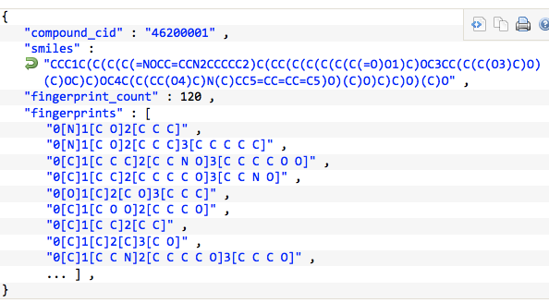

Molecular Similarity Database
Store Chemical Compounds – Fingerprints
Want to find compounds which are “close” to a given compound
Need to return quickly a small set of reasonable candidates
Few researchers working concurrently
Use Tanimoto association coefficient to compare two compounds based on their common fingerprints

Slide 34
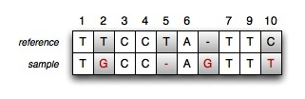
Big Data Genomics
Very large base of DNA sample sequences
Origin, collection method, sequence, date, …
Enumeration of mutations relative to reference sequence
Positions, mutation type, base
Need to retrieve efficiently all sequences showing a particular mutation
Similar to Content Management System pattern
Add tag array in sequence document with mutation names
Index tag array
Queries looking for affected sequences are indexed and very fast
Easy to setup, flexible representation and details for sequences, flexible evolution
Can scale to massive volumes

Slide 35

IoT: Large Industrial Vehicle Manufacturer
Shard 1
Primary
Shard 1
Secondary
Shard 1
Primary
Shard 1
Secondary
Central
Hub
Shard 2
Secondary
Shard 1
Secondary
Regional
Hub
Shard 3
Secondary
Regional
Hub
Shard 1
Primary
Regional
Hub
Shard 1
Secondary

Slide 36
What database do you need for your business?

Slide 37




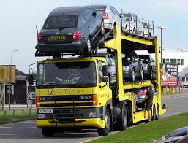

What vehicle do you want for a race?

Slide 38
WHAT ARE YOU TRYING
TO ACHIEVE?

Slide 39
The important aspect of MongoDB
MongoDB was not designed for niche use cases
MongoDB strives to have excellent characteristics applicable to a very broad range of use cases
MongoDB is the most balanced database for Enterprise applications and performance

Slide 40
Technical: Why MongoDB
High performance (1000’s – millions queries / sec) - reads & writes
Need flexible schema, rich querying with any number of secondary indexes
Need for replication across multiple data centers, even globally
Need to deploy rapidly and scale on demand (start small and fast, grow easily)
99.999% availability
Real time analysis in the database, under load
Geospatial querying
Processing in real time, not in batch
Need to promote agile coding methodologies
Deploy over commodity computing and storage architectures
Point in Time recovery
Need strong data consistency
Advanced security

Slide 41
Technical: Why MongoDB
High performance (1000’s – millions queries / sec) - reads & writes
Need flexible schema, rich querying with any number of secondary indexes
Need for replication across multiple data centers, even globally
Need to deploy rapidly and scale on demand (start small and fast, grow easily)
99.999% availability
Real time analysis in the database, under load
Geospatial querying
Processing in real time, not in batch
Need to promote agile coding methodologies
Deploy over commodity computing and storage architectures
Point in Time recovery
Need strong data consistency
Advanced security
If 3 or more apply to you….
you should try out MongoDB

Slide 42
Business: Why MongoDB
Management tooling and services
Ease of hiring
Commercial license
Ease of developer adoption
Global Support
Global Professional Services
IT ecosystem integration
Company stability
De facto standard for next generation database

Slide 43
Business: Why MongoDB
Management tooling and services
Ease of hiring
Commercial license
Ease of developer adoption
Global Support
Global Professional Services
IT ecosystem integration
Company stability
De facto standard for next generation database
If 2 or more are relevant to you….
you should consider MongoDB

Slide 44
Summary
MongoDB is for Systems of Engagement
Complements search engines, Hadoop and Data Warehouses
Does not replace these technologies
Wide range of use cases – and that’s the core point !
Excellent across many possible use cases, not just a few
Recognized by Gartner and Forrester
De facto standard for next generation database
Enterprise maturity and integration

Slide 45
We Can Help
MongoDB Enterprise Advanced
The best way to run MongoDB in your data center
MongoDB Management Service (MMS)
The easiest way to run MongoDB in the cloud
Production Support
In production and under control
Development Support
Let’s get you running
Consulting
We solve problems
Training
Get your teams up to speed
Notes:
What We Sell
We are the MongoDB experts. Over 1,000 organizations rely on our commercial offerings, including leading startups and 30 of the Fortune 100. We offer software and services to make your life easier:
MongoDB Enterprise Advanced is the best way to run MongoDB in your data center. It’s a finely-tuned package of advanced software, support, certifications, and other services designed for the way you do business.
MongoDB Management Service (MMS) is the easiest way to run MongoDB in the cloud. It makes MongoDB the system you worry about the least and like managing the most.
Production Support helps keep your system up and running and gives you peace of mind. MongoDB engineers help you with production issues and any aspect of your project.
Development Support helps you get up and running quickly. It gives you a complete package of software and services for the early stages of your project.
MongoDB Consulting packages get you to production faster, help you tune performance in production, help you scale, and free you up to focus on your next release.
MongoDB Training helps you become a MongoDB expert, from design to operating mission-critical systems at scale. Whether you’re a developer, DBA, or architect, we can make you better at MongoDB.

